Slide 1
VISIBLE-SURFACE DETECTION
What is hidden and what is visible?

Slide 2
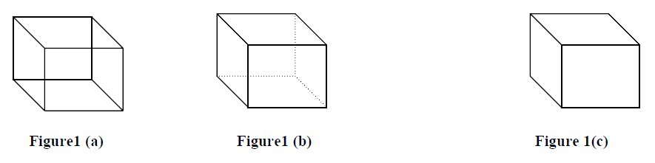
Hidden surfaces/hidden line algorithms
Back face detection is done differently in different spaces:
Object Space : In object space approach, we compare one surface with all the other surfaces. The comparison is done in world co-ordinates.
Image Space : In this approach, we determine the pixels which are illuminated by the visible surface. The visible surface is determined by the direction of normal to the plane.
Z-buffer (or Depth-buffer) method
and Scan-line method
Back-Face Removal

Slide 3
Approaches
Object-space approaches use the directions of a surface normal w.r.t. a viewing direction to detect a back face.
Image-space approaches utilize two buffers:
one for storing the pixel intensities
and another for updating the depth of the visible surfaces from the view plane.
area-subdivision method uses both object-space and image-space approach

Slide 4
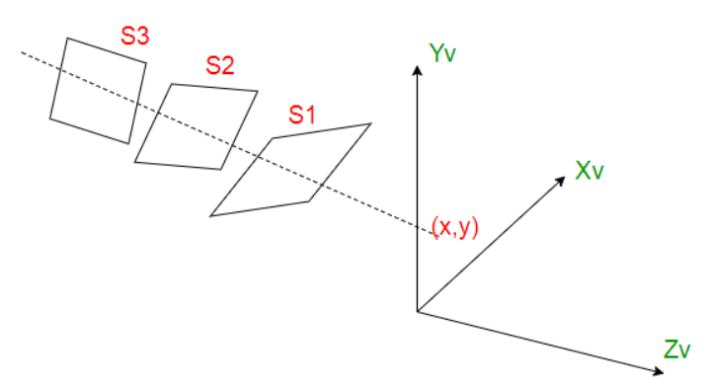
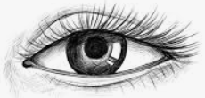
Z-Buffer (or Depth-buffer) Algorithm (image space approach )
is a fast and simple technique for identifying visible-surfaces.
For each pixel position (x,y) on the view plane, the surface with the smallest z-coordinate at that position is visible.
Let S1, S2, S3 are the surfaces.
The surface closest to projection plane is called visible surface.

Slide 5
In this method, 2 buffers are used : 1. Frame buffer(Refresh Buffer)
- stores the intensity value of the pixel at (x,y)
2. Depth buffer – stores the depth value(z-value) at (x,y)

Slide 6
Z-Buffer Algorithm
Given: A list of polygons {P1,P2,…..,Pn}
Output: A COLOR array, which display the intensity of the visible polygon surfaces.
Initialize:
z-buffer(x,y):=0; and
COLOR(x,y):= Back-ground color. (Refresh Buffer)
Begin
For (each polygon P in the polygon list) do
{
For (each pixel (x,y) that intersects P) do {
Calculate z-depth_{new} of P at (x,y)
If (z-depth_{new} < z-buffer[x,y]) then {
z-buffer(x,y)=z-depth;
COLOR(x,y)=Intensity of P at (x,y); }
}
}

Slide 7
Z-Buffer (or Depth-buffer) Algorithm
Algorithm,
a buffer of the same size as the frame buffer, is set up which holds depth information.
Each element of the depth buffer corresponds to a pixel in the frame buffer and initially holds the maximum depth in the scene.
The frame buffer is cleared to the background colour.
As each polygon is scan-converted, the depth at each pixel is calculated and compared with the corresponding depth in the depth buffer.
If the depth is less than that stored in the depth buffer (i.e.,nearer the viewer) then that pixel is set in the frame buffer with the polygon colour at that point and the depth buffer is set to the polygon depth.
If the polygon depth is greater (i.e., farther away from the viewer) than depth buffer depth at that point then that pixel is not written to the frame buffer.

Slide 8
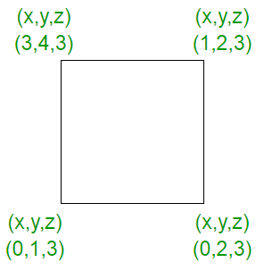
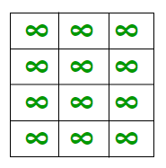
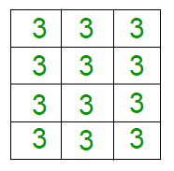
Example
2. In starting, assume that the depth of each pixel is infinite.
3. the depth value is 3, on applying the algorithm, the result is:
1.the polygon given as

Slide 9
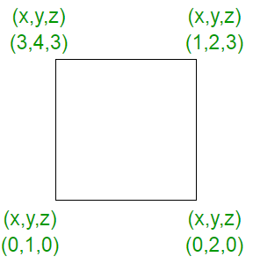
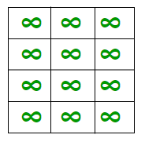
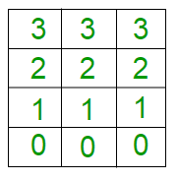
Contd…
4. Consider another polygon with different z-values that varies from 0 to 3
5. In starting, the depth of each pixel will be infinite as :
the z values generated on applying the algorithm

Slide 10
Advantages (z-buffer method):
1) Easy to implement and it requires no sorting of surface in a scene.
2) An arbitrary number of objects can be handled because each object is processed one at a time. The number of objects is limited only by the computer’s memory to store the objects.
3) Simple hardware implementation.
4) Online algorithm (i.e., we don’t need to load all polygons at once in order to run algorithm).

Slide 11
Disadvantages:
1) Doubles memory requirements (at least), one for z-buffer and one for refresh-buffer.
2) Device dependent and memory intensive.
3) Wasted computation on drawing distant points that are drawn over with closer points that occupy the same pixel.
4) Spends time while rendering polygons that are not visible.
5) Requires re-calculations when changing the scale.
6) Works only with opaque surfaces

Slide 12
performance
The performance of
Z-buffer method is low for simple scenes and high with complex scenes.
Scan-line methods are effectively used for scenes with up to thousand polygon surfaces.

Slide 13
Q-How does the z-buffer algorithm determine which surfaces are hidden?
Solution: Z-buffer algorithm uses a two buffer area each of two-dimensional array, one z-buffer which stores the depth value at each pixel position (x,y), another frame-buffer which stores the intensity values of the visible surface. By setting initial values of the z-buffer to some large number (usually the distance of back clipping plane), the problem of determining which surfaces are closer is reduced to simply comparing the present depth values stored in the z-buffer at pixel (x,y) with the newly calculated depth value at pixel (x,y). If this new value is less than the present z-buffer value, this value replaces the value stored in the z-buffer and the pixel color value is changed to the color of the new surface.

Slide 14

Q-What happens when two polygons have the same z value and the z-buffer algorithm is used?
Solution: z-buffer algorithms, changes colors at a pixel if z(x,y)<z^{buf}(x,y), the first polygon surface will determine the color of the pixel.
The depth-buffer is especially useful when it is difficult to order
the polygons in the scene based on their depth, such as in the case shown below:

Slide 15
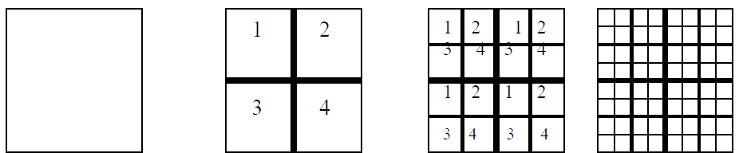
Area-Subdivision method: (Warnock’s Algorithm)
an image-space method
but uses object-space operations reordering (or sorting) of surfaces according to depth.
If the tests indicate that the view is sufficiently complex, we subdivide it.

Slide 16
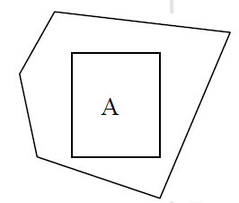
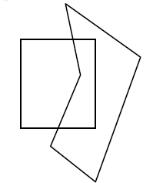
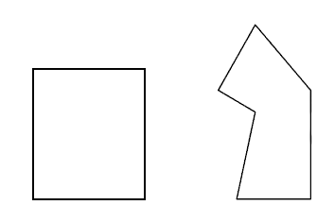
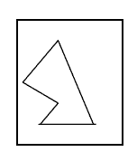
Cases:
There are 4 possibilities:
1) Surrounding polygon: Polygon that completely contains the area (a)).
2) Intersecting (or overlapping) polygon: Polygon that intersects the area (b)).
3) Contained polygon: polygon that is completely contained within the area(c)).
4) Disjoint polygon: Polygon that is completely outside the area (d).
(a)Surrounding (b)Intersecting (c)Contained (d)Disjoint

Slide 17
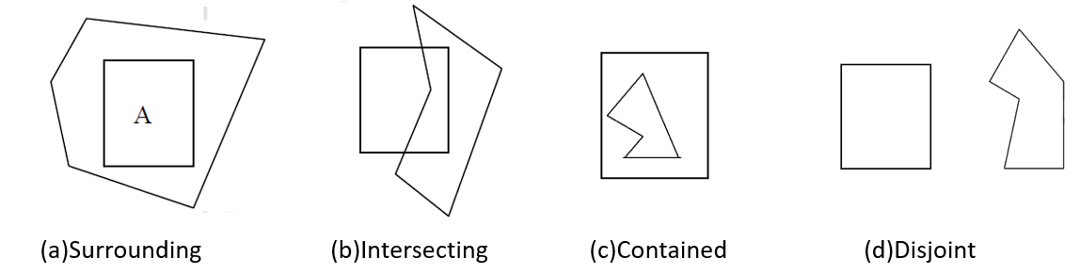
Decission Making:
Case 1: If All the polygons are disjoint from the area
then, the background color can be displayed in the area.
Case 2: If Exactly one polygon faces, after projection, intersecting or contained
then the area is first filled with the background color, and then the part of the polygon contained in the area is scan converted.
Case 3: If There is a single surrounding polygon, but no intersecting or contained polygons
then the area is filled with the color of the surrounding polygon.

Slide 18
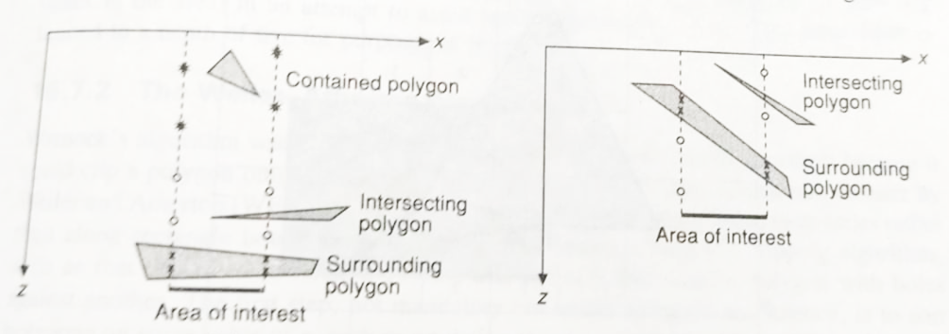
Case-4
If there is a surrounding polygon in front of any other surrounding, intersecting, or contained polygons
then the area is filled with the colour of the front surrounding polygon
Otherwise break the area into 4 equal parts and recurse.

Slide 19
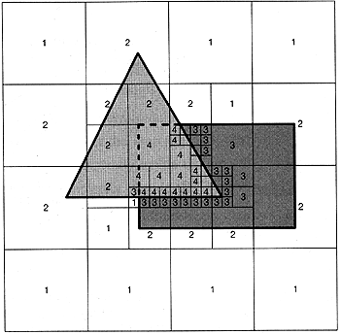
Example:
On a 1024x1024 raster display , at most 10 levels of subdivision are needed.

